Slide 1





MODULE 2 - Safety and security on Cyber Space
Sailaja Vadlamudi
2023

Slide 2

Recap of previous session Basic Security Policies (desktop, Usb, documents)
- Browser Security Implementations
- Safe Browsing - Cookies
- Clear Cookies & History data
Google Search ,Toll free numbers Password Security Measures
Email Security
Social Media Privacy ( FB, Insta, Twitter, Linked in, Youtube ),
- Privacy & Security Settings
- Multifactor Authentication
- Securing Personal DataHow to Use Google DOCS, Sheets, Forms, Meet
Instant Messenger Safety (Whats App, Snap Chat,Telegram)
Public WiFi
Windows Security and Updating of Software's and apps
Laptop Cameras, Web Cams
Android Security
- Play Store
- Installation of apps
- Permissions
Antivirus -List and Installation,

Slide 3


??

Slide 4

CLASS -2
Safe Browsing
i) Desktop
ii) Mobile
Antivirus and Security
Safe Practises and security
Downloading Apps from App Store and Play store
Mobile Security
Online Frauds

Slide 5
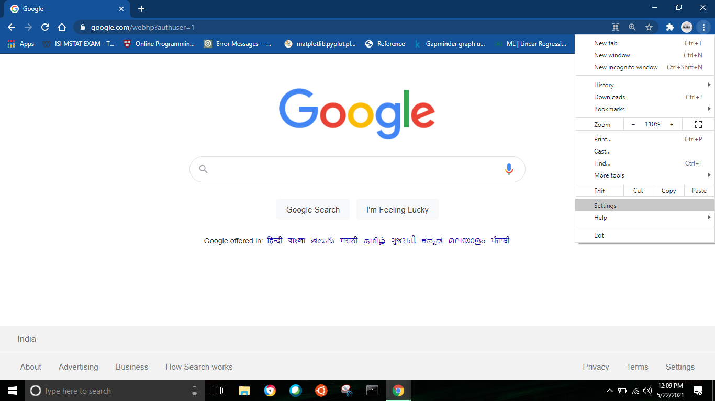
A. SAFE BROWSING
COOKIES: Cookies are bits and pieces of information from websites stored on your computer. They contain text those texts can be anything like ID, username, etc. Example: a web page could have a Hide link that hides a certain element on the page. The page can save this setting on your computer with a cookie. When you load the page in the future, the page can examine the cookie and automatically hide the element.
1. How can you turn off cookies?
Open google chrome and click on the three dots in the top right corner
and choose settings
Ctrl+H

Slide 6

SAFE BROWSING
Cookies
HTTP కుకీలు అనేది వెబ్ సర్వర్ ద్వారా సృష్టించబడిన డేటా యొక్క చిన్న బ్లాక్స్, ఒక వినియోగదారు వెబ్‌సైట్‌ను బ్రౌజ్ చేస్తున్నప్పుడు మరియు యూజర్ యొక్క వెబ్ బ్రౌజర్ ద్వారా యూజర్ కంప్యూటర్ లేదా ఇతర డివైజ్‌లో ఉంచబడుతుంది. ఆ గ్రంథాలు ID, యూజర్ పేరు మొదలైనవి కావచ్చు. ఉదాహరణ: వెబ్ పేజీలో పేజీలోని నిర్దిష్ట అంశాన్ని దాచే దాచు లింక్ ఉండవచ్చు. పేజీ సెట్టింగ్‌ను మీ కంప్యూటర్‌లో కుక్కీతో సేవ్ చేయవచ్చు. భవిష్యత్తులో మీరు పేజీని లోడ్ చేసినప్పుడు, పేజీ కుకీని పరిశీలించి, మూలకాన్ని స్వయంచాలకంగా దాచవచ్చు.

Slide 7

Session management -
ఉదాహరణకు, కుకీలు వెబ్‌సైట్‌లను వినియోగదారులను గుర్తించడానికి మరియు వారి వ్యక్తిగత లాగిన్ సమాచారం మరియు స్పోర్ట్స్ న్యూస్ వర్సెస్ పాలిటిక్స్ వంటి ప్రాధాన్యతలను రీకాల్ చేయడానికి అనుమతిస్తాయి
2. Personalization. మీ సెషన్‌లను వ్యక్తిగతీకరించడానికి కుకీలను ఉపయోగించే ప్రధాన మార్గం అనుకూలీకరించిన ప్రకటన. మీరు సైట్ యొక్క కొన్ని అంశాలు లేదా భాగాలను చూడవచ్చు మరియు మీరు ఆనందించే లక్ష్య ప్రకటనలను రూపొందించడంలో సహాయపడటానికి కుకీలు ఈ డేటాను ఉపయోగిస్తాయి
3.Tracking. వినియోగదారులు గతంలో చూసిన వస్తువులను ట్రాక్ చేయడానికి షాపింగ్ సైట్‌లు కుక్కీలను ఉపయోగిస్తాయి, సైట్‌లు తమకు నచ్చిన ఇతర వస్తువులను సూచించడానికి మరియు వస్తువులను షాపింగ్ కార్ట్‌లలో ఉంచడానికి వీలు కల్పిస్తాయి.

Slide 8
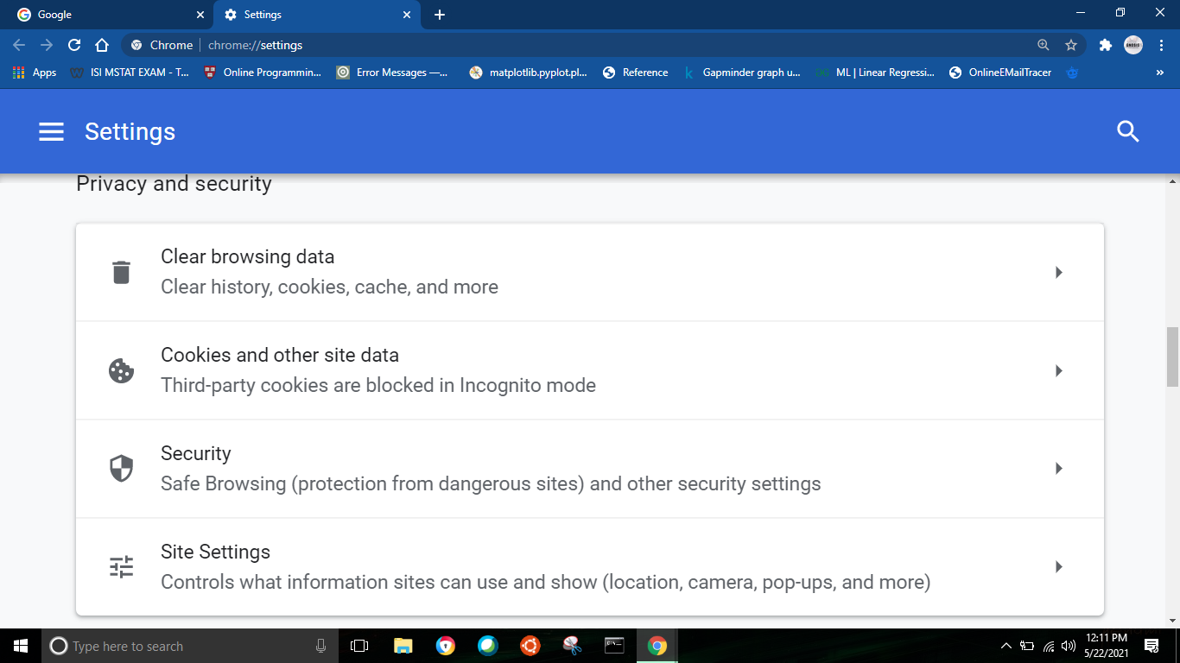
A. SAFE BROWSING – Desktop
Scroll down and you will see the options for cookies and other site data. Click on that option.

Slide 9
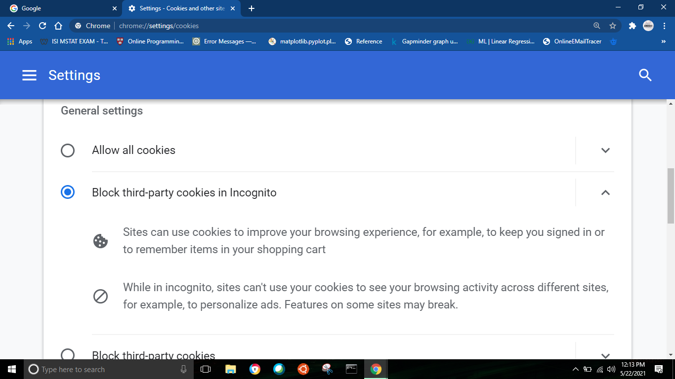
A. SAFE BROWSING – Desktop
By clicking on the cookies option, you will be redirected to the following webpage and from here you can actually control your cookies.
NOTE: Deleting or clearing cookies may worsen your browsing experience as cookies store data and keep you logged in the websites. Clearing cookies will log you out from all the websites.

Slide 10
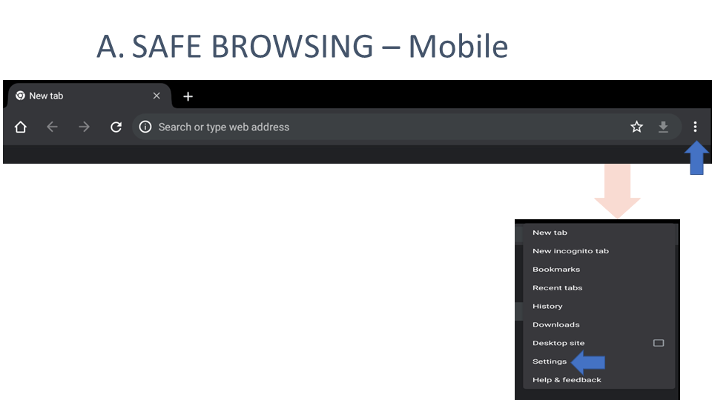

Slide 11

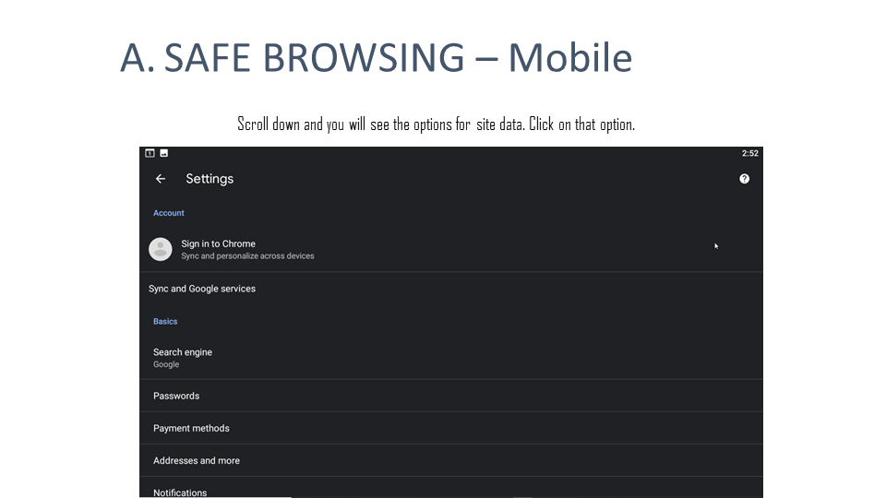

Slide 12
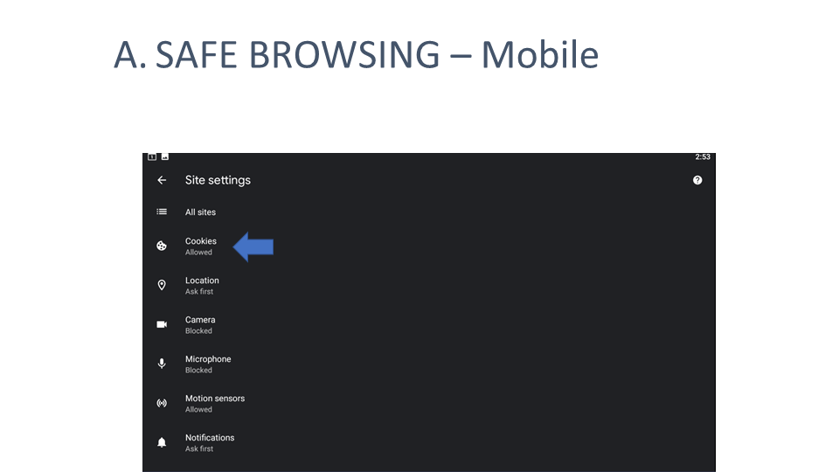

Slide 13
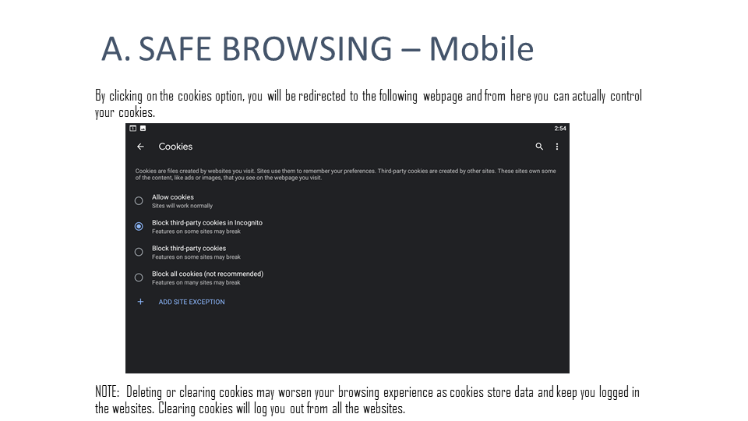

Slide 14
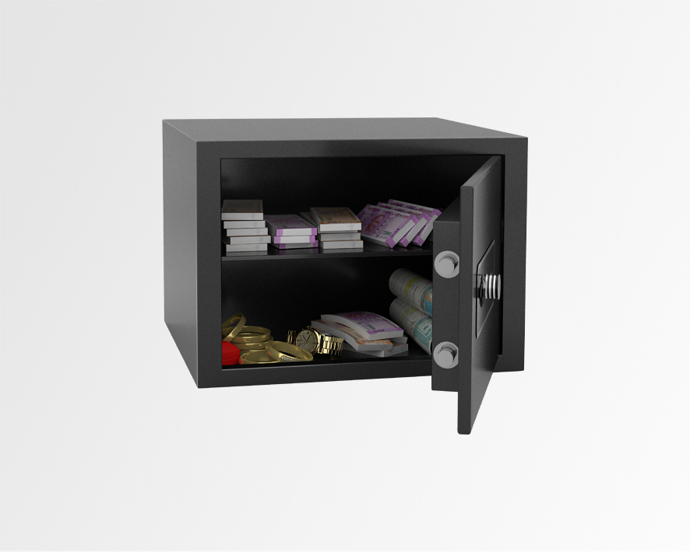

Passwords
మీ పాస్‌వర్డ్‌లను సేవ్ చేయడానికి మీరు అనుమతించినట్లయితే Google వాటిని సేవ్ చేస్తుంది. మీరు సేవ్ చేసిన అన్ని పాస్‌వర్డ్‌లను చూడటానికి, మీరు ఈ సైట్‌ను సందర్శించవచ్చు, మీరు మీ అన్ని పరికరాలను సమకాలీకరిస్తే, మీ అన్ని పరికరాల్లో Chrome లో మరియు మీ Android పరికరాల్లోని కొన్ని యాప్‌లలో పాస్‌వర్డ్‌లను ఉపయోగించవచ్చు. Chrome లో పాస్‌వర్డ్‌ల కోసం సమకాలీకరణ ఆన్ చేయబడినప్పుడు, మీ పాస్‌వర్డ్‌లు మీ Google ఖాతాకు సేవ్ చేయబడతాయి.
Google save your passwords if you allow it for saving them. In order to see what all passwords you have saved, you can visit this site, If you sync all your devices together, passwords can be used on Chrome on all your devices, and across some apps on your Android devices. When sync is turned on for passwords in Chrome, your passwords are saved to your Google Account.We can manage our passwords other than google account’s password by using a password manager. Google itself provides a complete list of ways to manage passwords on computer,
Key loggers - Hardware & Software
Delete passwords from Google Chrome

Slide 15
Passwords
Open Chrome
Right side of the toolbar, click on circular Profile, then click Lock Symbol (Passwords)
View saved passwords: Click the eye icon to the right of each password to see it. You’ll be prompted to type your computer password in to see it in plain text.
Delete saved passwords: Click the three vertical dots to the right of each password, then click Remove.
Notes:
https://blog.dashlane.com/view-delete-saved-passwords/

Slide 16
A. SAFE BROWSING
. AUTOFILL: 1. Open the Chrome app on your iPhone or Android phone.
2. Tap the three dots — located either to the right of the address bar (on Android) or the bottom-left corner of the screen (on iPhone) — and select "Settings."
3. To change your settings for autofill addresses, tap "Addresses and more" and toggle the feature on or off, or edit your saved information as necessary.
4. On an Android phone, you can also tap "Payment methods" above "Addresses and more" to change your autofill payment information and settings.

Slide 17
A. SAFE BROWSING
ii. PASSWORDS: Google save your passwords if you allow it for saving them. In order to see what all passwords you have saved, you can visit this site, If you sync all your devices together, passwords can be used on Chrome on all your devices, and across some apps on your Android devices. When sync is turned on for passwords in Chrome, your passwords are saved to your Google Account.We can manage our passwords other than google account’s password by using a password manager. Google itself provides a complete list of ways to manage passwords on computer, IPhone or on Android and you can find the link here.
iii. AUTOFILL: 1. Open the Chrome app on your iPhone or Android phone.
2. Tap the three dots — located either to the right of the address bar (on Android) or the bottom-left corner of the screen (on iPhone) — and select "Settings."
3. To change your settings for autofill addresses, tap "Addresses and more" and toggle the feature on or off, or edit your saved information as necessary.
4. On an Android phone, you can also tap "Payment methods" above "Addresses and more" to change your autofill payment information and settings.

Slide 18
A. SAFE BROWSING
6. Threats and Securities:
a. Chrome extensions can perform a variety of tasks, from showing the Alexa ranking of websites to blocking ads to processing cryptocurrency payments on-site, and much more.
b. Some extensions might request access to a microphone or webcam, and others might require permission to modify web page content.
c. Chrome has a Web Store where developers can publish extensions and users can install them on their browsers.
d. Despite the best efforts of Google to stop hackers or notorious people from doing misharm to individuals, we all need to be aware of the security issues they possess.
e. Malicious actors disguise their malware under the guise of extensions that perform useful tasks. Once the user installs the extension, hackers can perform various harmful tasks without the user’s knowledge.
f. What makes malicious extensions especially dangerous is that once installed, users allow them the freedom to do anything they want, including sending the user’s data to clandestine servers without being flagged as malicious activity.

Slide 19

Social Media
Social networks — Connect with people
Media sharing ,networks — Share photos, videos, and other media
Discussion forums — Share news and ideas
Bookmarking and content curation networks — Discover, save, and share new content
Consumer review networks — Find and review businesses
Blogging and publishing networks — Publish content online
Interest-based networks — Share interests and hobbies
Social shopping networks — Shop online
Sharing economy networks — Trade goods and services
Anonymous social networks — Communicate anonymously

Slide 20


Slide 21

SOCIAL MEDIA - Facebook
a. PASSWORDS: Easy passwords can be hacked, and although it’s been said to stop using the same password for multiple accounts, most people feel it’s a lot easier to do that. Don’t! It’s important to use a strong password that has a combination of characters, numbers and letters.
b. TWO FACTOR AUTHENTICATION: Facebook has made it possible to utilize a two-factor authentication to ensure an additional layer of security. Users can set this up in the security and login section of the account. Once this is activated, the user account will also require a code (usually sent to the phone) to log in.

Slide 22
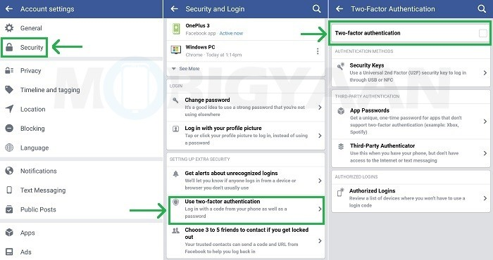

Slide 23
SOCIAL MEDIA - Facebook
c. POSTS: Securing posts by restricting who sees them is key. If the user is concerned about their privacy and taking all the precautions necessary to monitor who is able to see their account, this will work. Users can also restrict individuals from seeing posts where they are tagged. Someone may also want to block someone from seeing their friend list. This can be done by editing the privacy within the friends option. In order to avoid anyone’s comments or posts on the user’s timeline, it’s best to create a setting where everything is reviewed prior to being posted on the page.
d. FRIEND LISTS: More often than not, people receive random friend requests. If there is not direct affiliation to that request, it’s better to ignore and delete.

Slide 24
SOCIAL MEDIA - Facebook
e. REPORTING :
1. Go to the person’s profile. You can do so by searching for his or her name in the search bar, or finding them in your newsfeed.
2. Click on the three dots icon. On mobile, it’s found beneath the user’s name and titled ‘More.’ On the desktop, it’s the bottom right of the user’s cover photo.
3. Select ‘Give feedback or report this profile’.
4. Choose the reason you’re reporting that person. For more reporting ways, you can check the facebook help center here.

Slide 25
SOCIAL MEDIA - Facebook
f. RECOVERY:
i. If your facebook was hacked then you can easily report the incident here.
ii. If your account is hacked and you are logged out, open the facebook account and tap on ‘NEED HELP’.
iii. After clicking on NEED HELP, a menu will appear. Tap on forget password.
iv. Enter your email address or phone number. Tap the text box at the top of the page, then type in the email address or phone number that you use to log into your Facebook account.
v. Tap on search. It's a blue button below the text box. This should bring up your Facebook account.
vi. Select an account recovery method. Tap one of the account recovery options at the top of the page:
1. via email - Facebook will send a reset code to your Facebook account's email address.
2. via SMS - Facebook will text a reset code to your Facebook profile's registered phone number.
3. Tap on continue. Doing so will prompt Facebook to email or text a code to you.
4. Depending on the chosen method, you will get the code either on email or by SMS.
5. You can enter the code and tap on continue. Then you can logout of any other devices and set a new password.

Slide 26


SOCIAL MEDIA - Instagram
a. Use two-factor authentication to log in to Instagram safely: Two-factor authentication is a new security feature that helps safeguard your account by requiring something you know (your account username and password) and something you have (your mobile phone) every time you log into your Instagram account from an unknown device. Meaning, if someone has your password but does not have your phone, they cannot access your account. You can find the instructions here.
b. Choose who sees your posts with a private account: Setting your account to private is simple – navigate to the “Settings” gear from your profile page, and toggle “Private Account” to the “on” position. From there, you will need to approve every follow request moving forward.
c. Block anyone you don’t want to see your posts: To block an account, navigate to that account’s profile, open the “…” menu in the upper right corner and tap “Block User.”

Slide 27
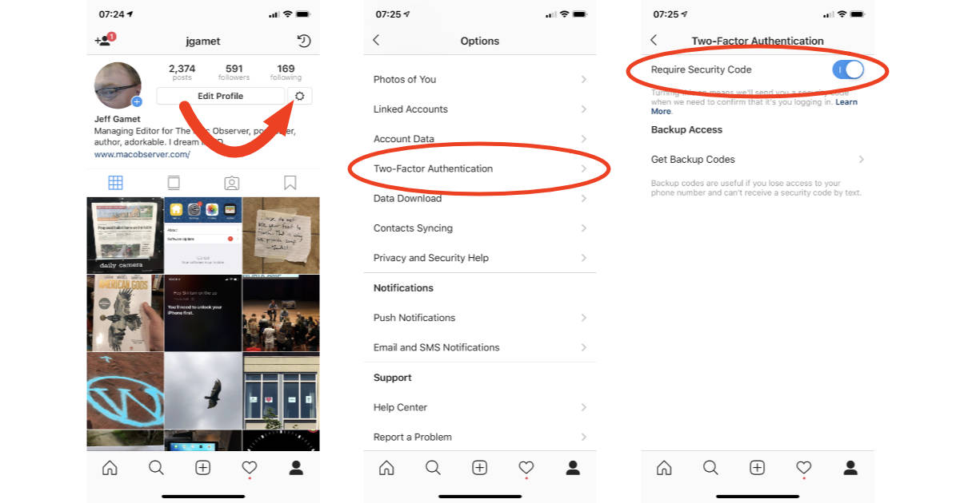

Slide 28
SOCIAL MEDIA - Instagram
d. Report any abuse, bullying, harassment or impersonation:
i. To report a comment, swipe to the left and tap the arrow.
ii. To report a specific post or an account, tap the “…” menu and then “Report.”
iii. Or, you can also fill out this form online and the Instagram review team will determine if the comment, post or account should be taken down.
iv. If you believe someone is impersonating you or someone you know on Instagram then go ahead and fill this form.
e. Support a friend in need: If you see someone posting content about suicide or self-injury and think immediate action needs to be taken, contact local law enforcement right away.Reach out to your friend over the phone, over Direct message, or in person to check in. View more resources in the Instagram Help Center.

Slide 29
SOCIAL MEDIA - Instagram
f. EMAILS FROM INSTAGRAM: This setting of instagram is really handy and will always help you in tracking your account. Go to the settings tab on your account and choose the security option. There you will see emails from the instagram option, mention your emails and turn it on. This way, everytime instagram sends you an email, it will appear in your email inbox as well as in your instagram account.
g. RECOVERY:
i. If you can no longer access your account and you suspect that the hacker has changed your password, then you’ll need to use Instagram’s account recovery.
ii. Go to the Instagram login page and click ‘Forgot password?’
iii. Enter your phone number, email address, or username and click ‘Send Login Link.’ Instagram will then send you an email to help you recover your account.
iv. Once you’ve regained access to your account, you should visit our Instagram security guide here.

Slide 30
SOCIAL MEDIA - Instagram
h. 2 Factor Authentication: Using 2FA gives you 2 layer security. Everytime you try to login, you will have to provide an additional code as well as your password. To enable 2FA, go to your settings tab on instagram account and then navigate to the security tab. Turn on the text message option.

Slide 31

SOCIAL MEDIA - Twitter
a. Use a strong password that you don’t reuse on other websites.
b. Use two-factor authentication.
c. Require email and phone number to request a reset password link or code.
d. Be cautious of suspicious links and always make sure you’re on twitter.com before you enter your login information.
e. Never give your username and password out to third parties, especially those promising to get you followers, make you money, or verify you.
f. Make sure your computer software, including your browser, is up-to-date with the most recent upgrades and anti-virus software.
g. Check to see if your account has been compromised

Slide 32
SOCIAL MEDIA - Twitter
h. 2 Factor Authentication:
i. Navigate to your account and tap settings and privacy.
ii. Tap on account and then navigate to security.
iii. There you will use 2 options. Tap on two factor authentication .
iv. Check the box for the Text message.
i. Recovery:
i. Password Reset: Reset your password by requesting an email from the password reset form. Try entering both your username and email address, and be sure to check for the reset email at the address associated with your Twitter account.
ii. Contact Support: If you still can't log in, contact us by submitting a Support Request. Be sure to use the email address you associated with the hacked Twitter account; we'll then send additional information and instructions to that email address. When submitting your support request please Include both your username and the date you last had access to your account.

Slide 33

SOCIAL MEDIA - WhatsApp
a. Privacy: Set your profile photo, last seen, and about, to be seen by everyone, contacts only, or no one.
b. Block Unwanted Users
c. Account info: Get a report of your WhatsApp account information and settings.
d. Enable Two-Step Verification:
i. Head towards your whatsapp application and open the settings tab.
ii. In the settings tab. Select Account.
iii. After navigating into the Accounts tab, you will see the option for two step verification.
iv. Tap on it and create a 6 digit pin for extra security.

Slide 34
SOCIAL MEDIA - WhatsApp
e. Recovery: The best way to recover your whatsapp account, is to log into your whatsapp account from another number. When you try to log into another device, whatsapp will ask you for the 6 digit verification code and the moment you enter the verification code, the hacker will be automatically logged out. This method is only possible if you have enabled two step verification.

Slide 35

SOCIAL MEDIA - YouTube
a. Since youtube is connected to your google account, you get one more reason to keep your google account more secure.
b. Always be aware of shortened links. They can contain malware and viruses which you are not aware of.
c. Do not share any links via emails.
d. To keep your youtube account secured and managed, you can find more information here.
e. If your account is hacked and you are not able to access your account, please refer to the support guide provided by google itself.

Slide 36

Fraudsters lead to websites that will install malware on machines
Wait for official movie release, do not visit illegal streaming.
Use antivirus and ensure it is updated

Slide 37
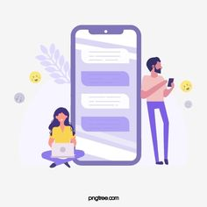
Understanding Operating Systems
THREATS: The Android OS is especially vulnerable to malware threats. Android Malware comprised just 24 percent of all mobile malware threats in 2010, according to a recent Juniper Networks study, but now comprises a whopping 90 percent of all malware. The open nature of the platform — which allowed so many Android devices to flood the market in the first place — also makes it an ideal target for malware creators. They can get their software onto users' devices without taking care to expertly hide the malicious aspects of it. The bulk of this malware is revenue-driven, with more than 75 percent of the malicious software being used to trick users into sending texts to premium services for a fee. According to Juniper, each attack can bring in $10 for the attacker, a hefty haul when multiplied by the millions of devices out there.

Slide 38

SAFE PRACTICES AND SECURITY:
Keeping Windows up to date
Click on the Windows Start Menu and select or type 'Control Panel'.
Select or type 'Windows Update".
Select 'Check for Updates'.
Install all recommended updates.
Select the Start Windows logo Start button button, and then go to Settings Gear-shaped Settings icon > Update & Security Circular arrows Sync icon > Windows Update Circular arrows Sync icon.
Settings – About phone- update
Open your phone's Settings app.
Bottom Tap System ->Advanced- > System update
See your version , you will see update status , follow steps on the screen
Notes:
Netflix access- games access

Slide 39

SAFE PRACTICES AND SECURITY:
1. STAY UP TO DATE : Updating your mobile security software isn't just a way to get enhanced features and better speeds, as Google and your device manufacturer pack a lot of back-end fixes into these updates.
2. AVOID THIRD PARTY APPLICATIONS: The breadth of available Android apps is one of the features that draw people to the platform, and Android makes it fairly easy to install applications from sources other than the official app store. While there are some interesting apps out there that are not available through Google, this is a great way to get malware onto your device.

Slide 40
SAFE PRACTICES AND SECURITY:
Keeping Windows up to date
Click on the Windows Start Menu and select or type 'Control Panel'.
Select or type 'Windows Update".
Select 'Check for Updates'.
Install all recommended updates.
Modified – Apk’s mobile can be hijacked and malwares can be installed
Settings – About phone- update
Open your phone's Settings app.
Bottom Tap System ->Advanced- > System update
See your version , you will see update status , follow steps on the screen
Notes:
Netflix access- games access

Slide 41

Free Wi-Fi
Theft of Personal Information
Login credentials
Financial information
Personal data
Pictures
Malware Distribution
Viruses
Worms
Adware
Ransomware
Websites you are browsing

Slide 42
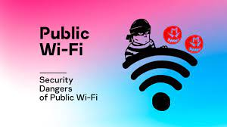
SAFE PRACTICES AND SECURITY:
3. AVOID FREE WI-FI: Free, public Wi-Fi is, in many ways, a blessing, as it provides a fast Internet connection for your device without costing a cent. But these unsecured connections could prove disastrous for your private information. It's just as easy for a hacker or thief to connect to free Wi-Fi as it is for you, and once you're both on the same network, they can easily see almost all the information you're sending to the Internet.
4. GET PROTECTED: There are plenty of mobile antivirus available in the market. One should protect their devices by making use of the antiviruses and keeping them updated as well. For true mobile security, stick with brand-name offerings. They may charge for their constantly updated service, but it's a small price to pay for true security. Most of these apps come with free trials, so you can try them before you make a purchase, and the best can even protect your PC, or multiple Android devices, at the same time.

Slide 43

C. APP STORE AND PLAY STORE:
a. CHECKING APP SECURITY:
i. Find out who the developer is : A quick Google search should provide you with verified info about the developer, such as a website. If the developer has created a number of apps, they are more likely to be trustworthy.
ii. Number of downloads : Check to see how many times the app has been downloaded. If it has lots of downloads, it’s more likely to be legit.
iii. Number of reviews : Check to see by how many people have actually put reviews. If it has lots of reviews, it’s more likely to be legit.
iv. Date Published : If you’re downloading Facebook Messenger and suddenly notice it was published just a few months ago, that’s a telltale sign the app is fake. Instead, look for an “updated on” date.
Don't install any application unnecessarily

Slide 44
C. APP STORE AND PLAY STORE:
Location
Storage
Gallery
Call logs
Contacts
Accessibility
SMS
Camera
Mic
Dangerous
Permissions – is the key for downloading apps

Slide 45
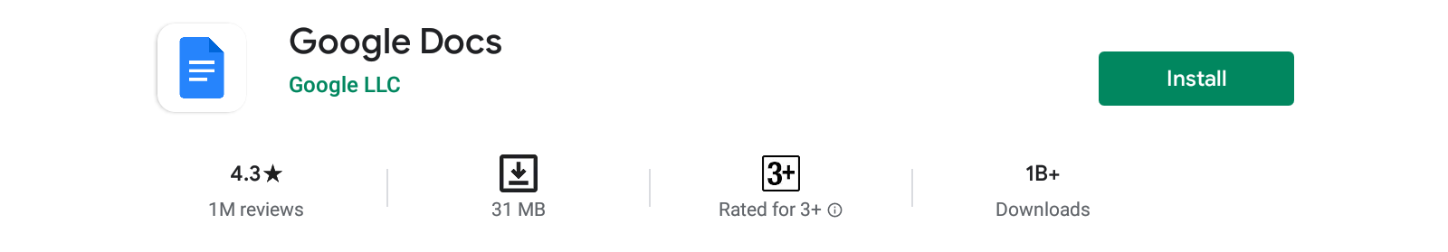
C. APP STORE AND PLAY STORE:
Developer
No. of Reviews
No. of Downloads

Slide 46

b. CHECKING WEBSITE SECURITY:
i. USE YOUR OWN BROWSER SAFETY KIT: Today’s most popular web browsers already include security features to help you stay safe online. These built-in browser tools can block annoying pop-ups.
ii. USE WEBSITE SAFETY CHECK TOOL: To quickly check if a site is legit or a specific URL is safe, you can use a website safety checker like Google Safe Browsing. According to their page, “Google’s Safe Browsing technology examines billions of URLs per day looking for unsafe websites,” which makes this a great website safety-check tool.

Slide 47

D. MOBILE SECURITY FEATURES: Android
i. App sandbox
ii. App signing
iii. Authentication
iv. Biometrics
v. Trusty Trusted Execution Environment (TEE)
vi. Verified Boot

Slide 48

E. DIGITAL IDENTITY: a. How to find out if your email ID is hacked?
i. USE ‘Have i Been Pwned’: ‘Have I Been Pwned?’ is one of the best tools for checking your email accounts’ safety. You should go to the website and enter each of your email addresses. The site will check if your account has ever been part of a data breach or if your account details have been pasted to the public online. If either of those things is true, you know the account is more at risk.
ii. Use ‘Dehashed’: Dehashed is another powerful tool for checking the safety of your online information. Unlike the above tool, Dehashed covers more than email addresses. You can enter any search term, such as an old username, and the site will trawl the internet to see if any of your information is publicly available. The site includes tools to help you remove any personal data entries you come across.

Slide 49
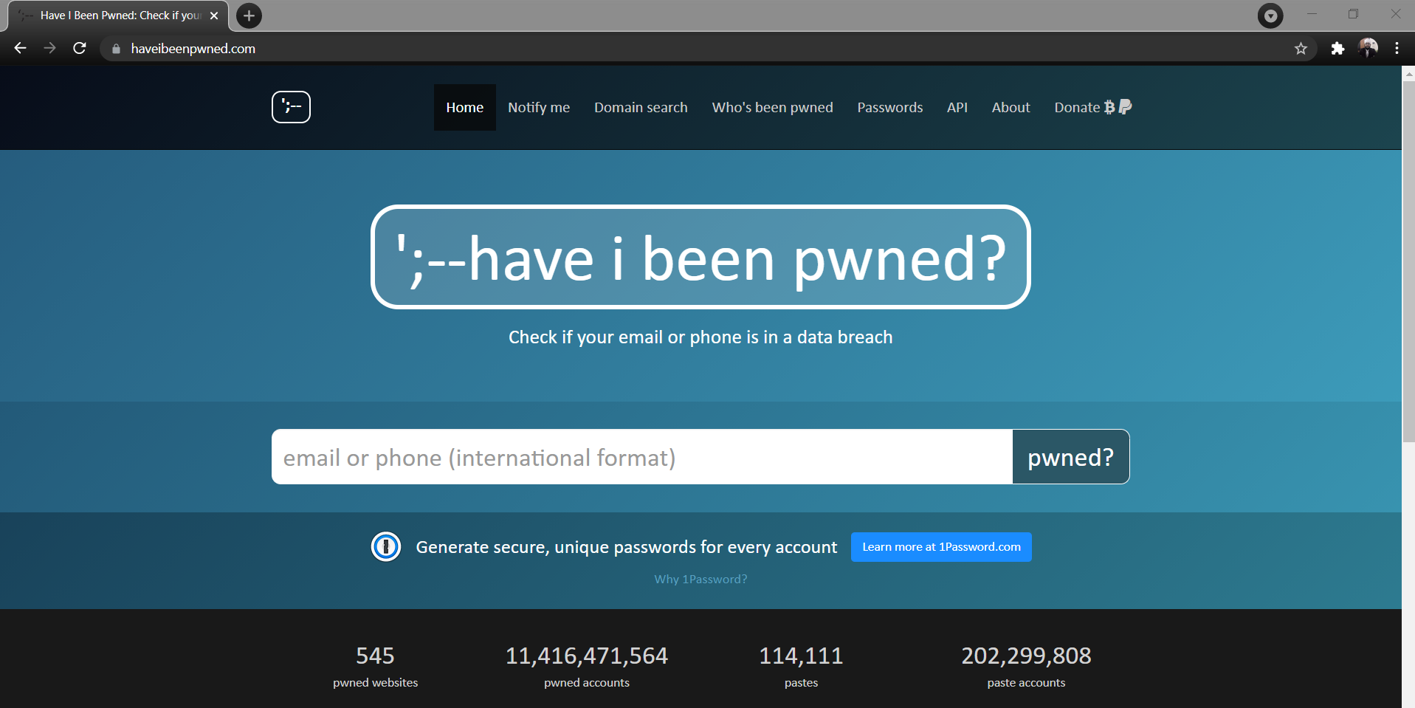
Enter Email ID in the search box and you can check if your email is part of a breach

Slide 50
E. DIGITAL IDENTITY: b. What should you do if your ID is hacked?
i. Notify your Friends, Family Members, and Followers
ii. Never pay a ransom
iii. Suspicious Logins:
1. Changing the password
2. Adding 2FA (Two-Factor Authentication)
3. Adding additional security levels the service provides.

Slide 51
E. DIGITAL IDENTITY: b. What should you do if your ID is hacked?
iv. Follow the hacked protocol:
1. Change passwords on all online accounts you still got access to and secure these as fast as possible.
2. Ensure that you have secured your main email account, changed the password, implemented a recovery email, and enabled Two-Factor Authentication.
3. Let all your friends and family members know that you have been hacked to ensure that they are not scammed by the hackers pretending to be you.
4. Do an assessment of which accounts have been hacked and what information the hackers have received about you and your network.
5. Do not create a new profile or account on the same platform you were hacked using the same credentials like email or phone number. This makes it much harder to recover your account.

Slide 52
E. DIGITAL IDENTITY: c. What is IP address and importance:
The primary network communications protocol used on networks today is the IP (Internet Protocol). IP relays or transfers network packets, also known as datagrams, to destinations on local networks or across the public Internet. It defines the structures which encapsulate information as well as the legal addressing methods used to identify the source and destination network hosts or computing devices.
IP is primarily responsible for providing legitimate network addresses and the encapsulation and routing of data packets across one or many IP-based networks. The primary functions of the protocol are providing identification of computer hosts and a straight-forward location service. The primary version of the protocol in use on the Internet today is IPv4, Internet Protocol Version 4. The succeeding protocol to IPv4 is IPv6 (Internet Protocol Version 6) that is slowly being adopted by industry after testing over Internet 2.
You can check your IP address by going on this site.

Slide 53
E. DIGITAL IDENTITY: d. How to trace and track IP addresses
i. You can trace and trace someone’s IP address by using IP Lookup.
ii. You will get the following information by tracking the IP:
1. The ISP and organization's name
2. The IP's host name
3. The country it's in
4. The region/state
5. The city (see below)
6. The latitude and longitude of the location (a best guess)
7. The area code for that region
8. Any known services running on that IP

Slide 54

F. Website and its fundamentals a. Websites and Webpages:
i. A Webpage is an electronic document written in a computer language called HTML (Hypertext Markup Language). Webpages may contain text, graphics, video, animation, and sound, as well as interactive features, such as data entry forms.
ii. A Website is one or more Web Pages that relate to a common theme. This set of pages goes together and the user is able to navigate from one page to the others via hyperlinks. Individual Web Pages are linked together through a system of hyperlinks, enabling you to jump from one page to another by clicking on the links. Websites are nonlinear. In other words, you can navigate through the content pages in any order you wish.
iii. The first page of any Website is called the homepage. Think of a homepage as the starting point of a Website. Like the table of contents of a book or magazine, the homepage usually provides an overview of what you'll find at the Website. It acts as an index, often indicating the content of the entire Website.

Slide 55
F. Website and its fundamentals b. Hyperlinks
Text links usually appear in a different color from the rest of the text, often in blue and underlined. When you move your cursor over a text link or over a graphic link, it will change from an arrow to a hand. The URL will also appear in the status bar at the lower left of your Web browser. Additionally, the words in hypertext often indicate what the content of the linked page will be.

Slide 56
F. Website and its fundamentals c. Web Browser
A Web browser is a software program used to access the World Wide Web. A browser (also known as client software) retrieves data from remote Web servers and displays it as a Web Page. The most popular browsers today are: Microsoft Explorer, Netscape Navigator, and Mozilla Firefox. All browsers basically work the same way. Once you know one, you can easily learn the others.

Slide 57
F. Website and its fundamentals d. Anatomy of a URL
i. Consider the URL: http://www.wlac.edu/online/index.htm
1. http:// -- Short for Hypertext Transfer Protocol, this indicates a hypertext document or directory. This does not need to be typed into the address field.
2. www. -- This indicates a page on the World Wide Web. Sometimes "www" is missing. A site with www. may or may not lead to the same site without it.
3. wlac.edu/ -- Called the domain name, it often tells you the name of a company, university, or organization. It can also tell you the country of origin.
4. online/ -- This is a directory or folder on the Web server that contains a group of related Webpages within the Website.
5. index.htm -- This is a Webpage inside the folder “online/.” Index.htm or start.htm usually indicates the homepage of a site. The suffix may appear as ”.htm” or “.html.” Since it is the last part of the string, you know that this is the page you are currently on.

Slide 58
Olx, Quickr
CM's daughter fell victim to a scam on OLX
UPI apps ask users to enter their UPI PIN or M-PIN while making a payment, which differs for every linked bank account.
This is not required to accept payments. So, if the app asks you to put this PIN after scanning the QR code, it should be the first alert .
Do not enter the code and cancel the transaction

Slide 59
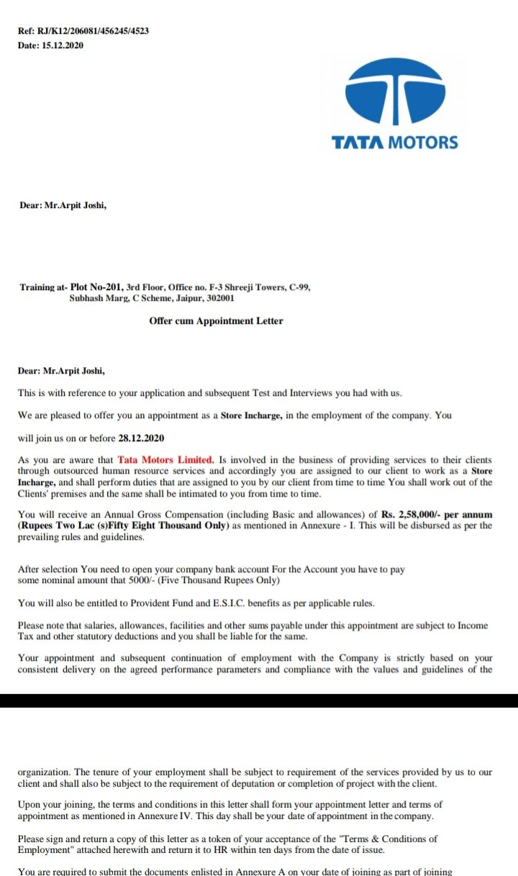
Fake job

Slide 60
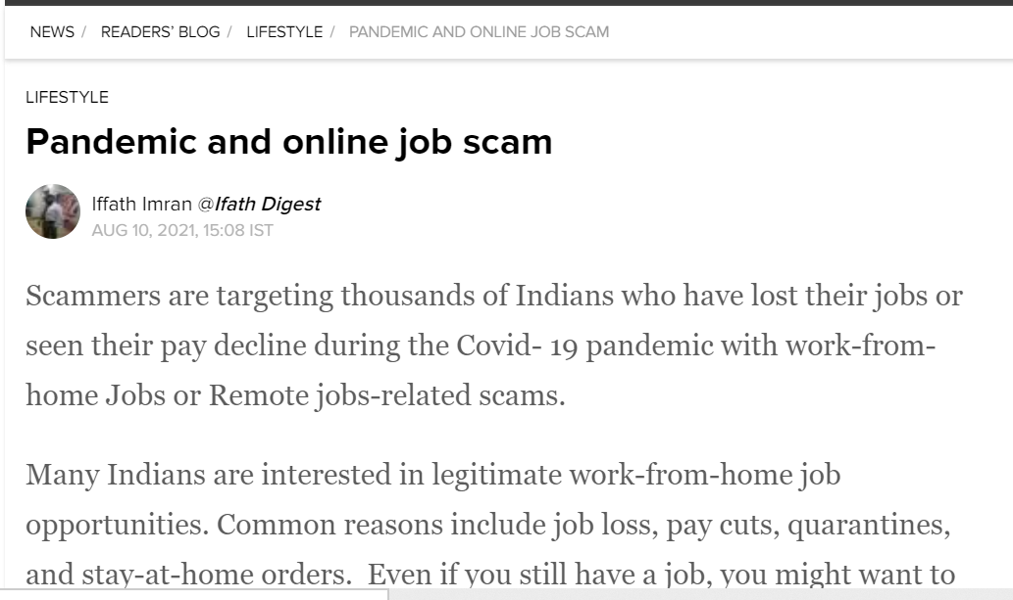

Remote Jobs

Slide 61
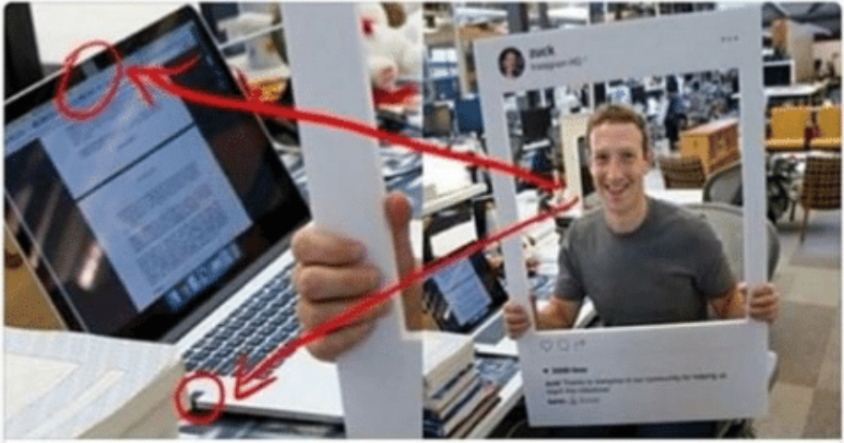
Laptop and Phone Cameras
Camera and audio jack of MacBook covered with tape
Hackers /Cyber Criminals can easily listen, watch and record. Using malware, they can also gain access to data by using camera or microphone

Slide 62
C. APP STORE AND PLAY STORE:
Location
Storage
Gallery
Call logs
Contacts
Accessibility
SMS
Camera
Mic
Dangerous
Permissions – is the key for downloading apps

Slide 63
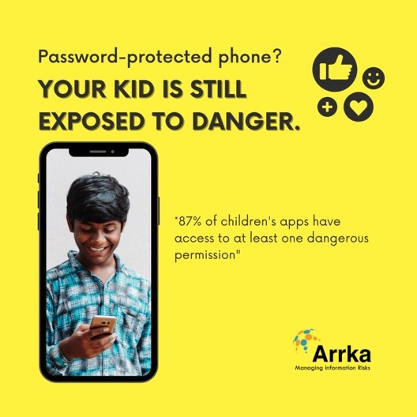

Slide 64

Online Discounts – Cheap/free
Cheap and Fake Products - – All the glitters are not gold
Amazon, Flipkart, Snapdeal
Zomato, Swiggy

Slide 65

What to do
RagaLabs
Dark Telugu
National Geographic
Computerphile
Learn Engineering
Unacademy
Ve project 1
Institute of human anatomy
GRANDPA KITCHEN
Amma Chethi Vanta

Slide 66


LEARN
EARN

Slide 67

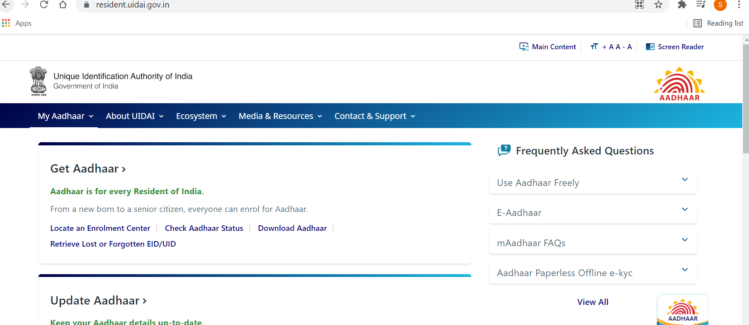
Stock / Schemes
SEBI – brokers approved applications
Schemes from gov.in sites

Slide 68

ANTIVIRUS AND SECURITY:
Need of an antivirus : Purpose of the antivirus solution or software is to guard against malicious software or scripts by blocking or quarantining this software that is identified, and alerting administrators that such action has taken place. The solution would detect and report on different types of malicious software that may be introduced or attempted to be installed on the systems and network, including endpoints such as mobile devices, desktops, laptops, servers, etc.

Slide 69

ANTIVIRUS AND SECURITY:
Use only one antivirus from the real site /app store on your devices
(Mobile Phones/desktop/laptop/tablet computers else it will slowdown
Source :https://www.av-comparatives.org

Slide 70
ANTIVIRUS AND SECURITY:
Where to install the antivirus: It should be installed on each and every device which is available. Anti-virus software should also be deployed on the network, including internet gateway, servers and end-user systems for protection from malicious code. The anti-virus solution should be properly maintained and updated accordingly.

Slide 71
ANTIVIRUS AND SECURITY:
When to scan: You should scan your devices on regular intervals for any malware or viruses. The anti-virus solution should perform periodic scans on electronic/optical media, files received over networks, electronic mail attachments, downloads, and web traffic to identify and remove malicious software. Malicious code that is identified should be blocked, quarantined, and an alert is sent to the administrators.

Slide 72
ANTIVIRUS AND SECURITY:
iv. Best Practices to adopt:
1. Virus protection should be installed on every machine on the network.
2. All antivirus clients, servers, and gateway products should be kept actively running and capable of generating audit logs at all times.
3. The master installation of the software should be enabled for automatic updates and periodic scans, and the servers should also have these features enabled.
4. The master installation should automatically push updates out to the systems and devices on the network.
5. Unauthorized software on information systems should be promptly identified and prevented from executing in accordance with the list of authorized software programs and rules authorizing the terms and conditions of usage.

Slide 73
Thank you

